Slide 1

TechCorp IAM Platform Implementation Plan
Ensuring Secure Access & Efficient Integration

Slide 2
Agenda: Navigating the IAM Journey
Introduction to IAM at TechCorp
Comprehensive Implementation Phases
Critical Milestones & Timelines
Essential Resource Planning
Integration Challenges & Solutions
Key Architectural Diagrams
Strategic Business Alignment
Conclusion & Next Steps

Slide 3



Introduction to IAM at TechCorp
TechCorp operates globally within a complex digital ecosystem, necessitating a robust IAM solution.
Centralized Identity
Improved Access Control
Enhanced Compliance
Unifying user identities across diverse systems for streamlined management.
Granular control over resource access, minimizing unauthorized entry points.
Meeting regulatory requirements and internal governance standards through auditable access logs.

Slide 4
Comprehensive Implementation Phases
Project Initiation (Week 1–2)
Define scope, key stakeholders, and success metrics.
Needs Assessment (Week 2–4)
Conduct a thorough audit of existing systems to identify current gaps.
Solution Design (Week 5–7)
Develop detailed role definitions, access flows, and architectural blueprints.
Implementation (Week 9–13)
Configure the IAM platform, including SSO and MFA setup.
Testing & QA (Week 14)
Execute comprehensive functional, security, and integration testing.
Deployment (Week 15)
Strategically roll out the IAM solution, either phased or company-wide.
Monitoring & Optimization (Ongoing)
Establish continuous monitoring and refine performance post-deployment.

Slide 5
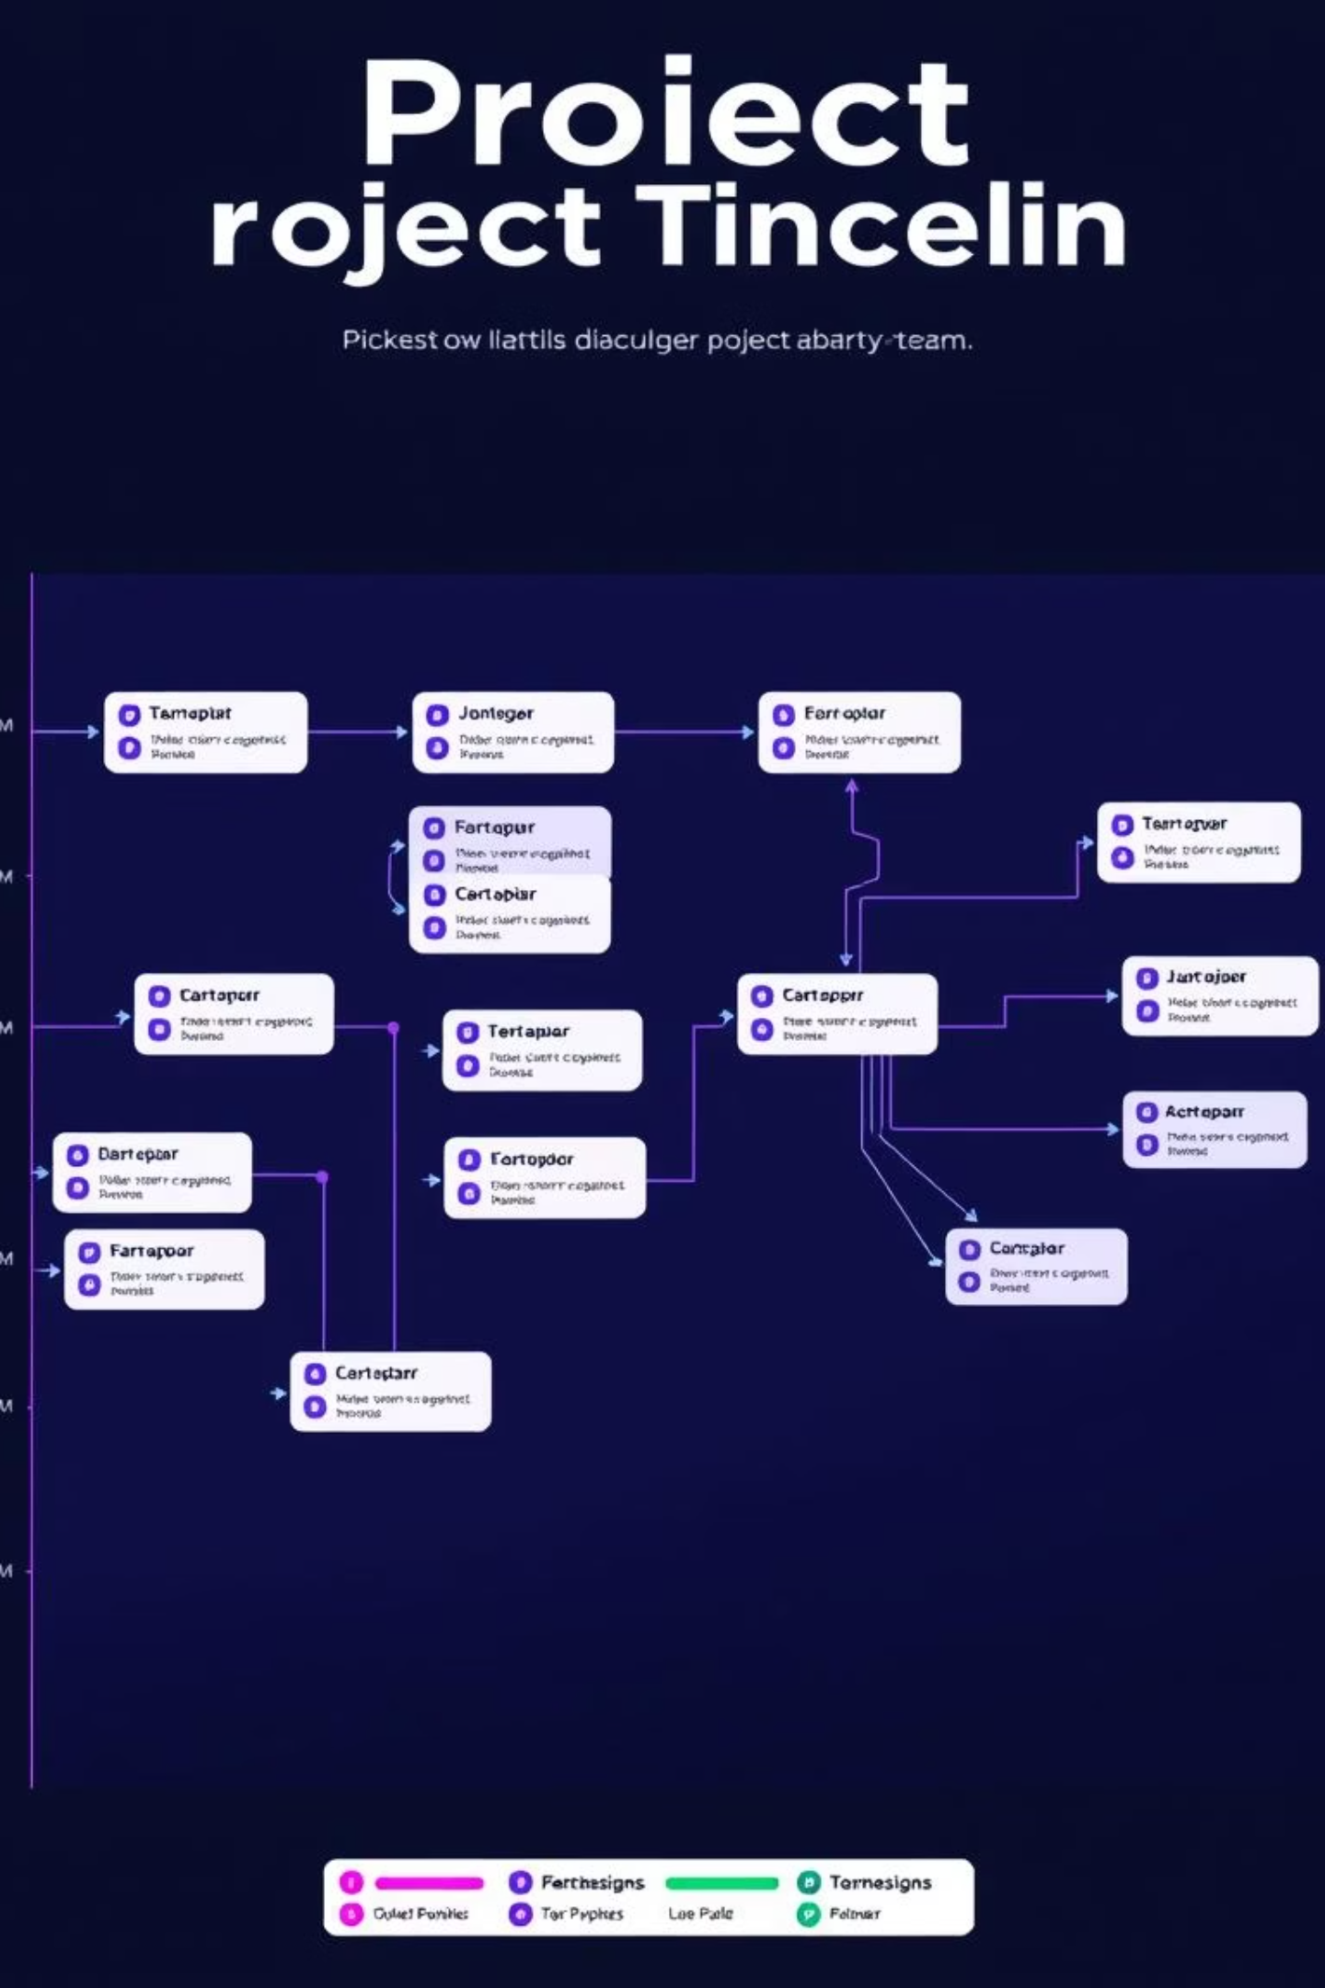
Critical Milestones & Timelines
Our phased approach ensures a systematic and controlled IAM platform rollout.
Planning Complete: End of Week 4, following needs assessment.
Design Lock: End of Week 7, after architecture blueprint approval.
Pilot Deployment: End of Week 15, targeting a select user group for initial feedback.
Full Rollout: End of Week 17, making IAM available to all TechCorp users.
Post-Implementation Review: Week 20, assessing success criteria and areas for improvement.

Slide 6
Essential Resource Planning
Human Capital
Technical & Financial
Dedicated Project Manager
IAM Tools (e.g., Okta, Azure AD)
IAM Architects & Integrators
Isolated Test Environments
Compliance & Security Officer
API Connectors for Integration
Dedicated Testing Team
Budget Allocation & Licensing Costs
Securing the right resources is paramount for a successful IAM implementation.

Slide 7
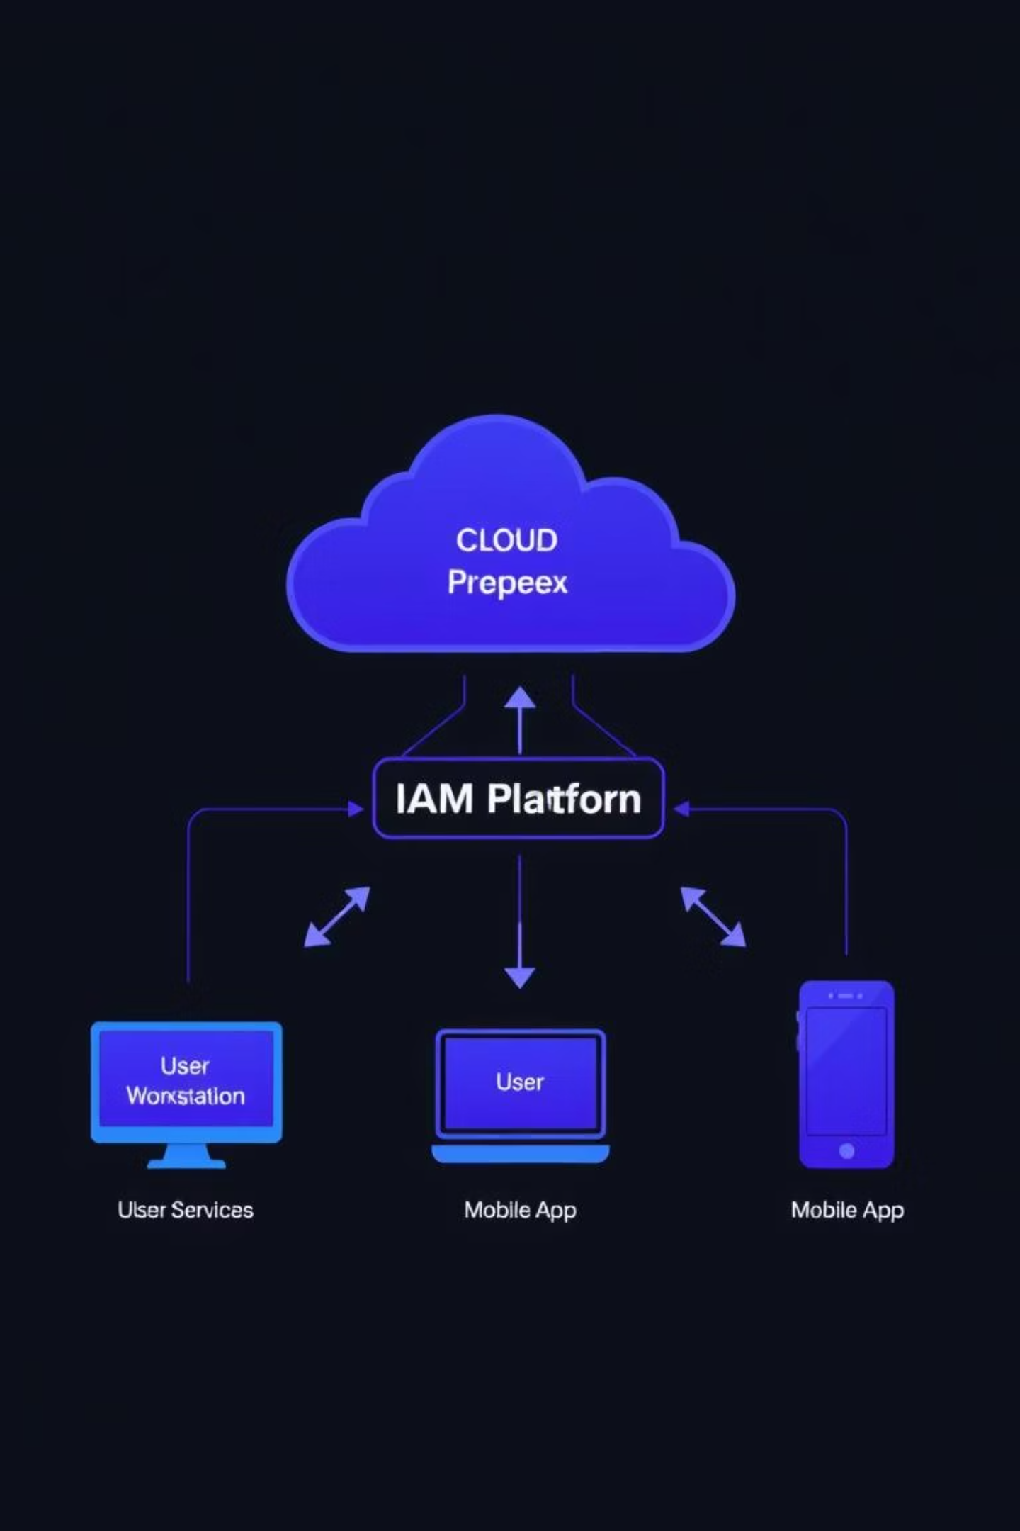
Integration Challenges & Best Practices
Overcoming hurdles to ensure seamless and secure IAM integration across TechCorp's ecosystem.
Challenges
Best Practices
Integrating with disparate legacy systems requiring custom adapters.
Standardize protocols (e.g., OAuth 2.0, SAML) for broad compatibility.
Ensuring real-time data synchronization across all integrated applications.
Automate user provisioning and de-provisioning workflows.
Maintaining a consistent, intuitive user experience with SSO.
Implement Role-Based Access Control (RBAC) for efficient permissions management.

Slide 8
Strategic Business Alignment
The IAM platform is more than security; it's a strategic enabler for TechCorp's future.
30%
25%
45%
Enhanced Cybersecurity
Streamlined Operations
Support Scalability
Reduced attack surface with MFA and strict compliance.
Centralized access control and automated workflows.
Modular IAM setup adaptable to future growth.

